Slide 1

Waste Detection and Segregation using Qualcomm Innovators Development kit
Under able guidance of : ​
Dr. Sachin Chaudhari
Associate Professor , SPCRC , IIITH
A Team effort by- Sheta ke kptanz
Teaching Assistant- Ansh Shah​​
This presentation details a project focused on waste detection and segregation utilizing the Qualcomm Innovators Development Kit using computer vision and algorithms. The project, spearheaded by "SHETA KE KPTANZ," addresses the growing issue of waste management in India.

Slide 2
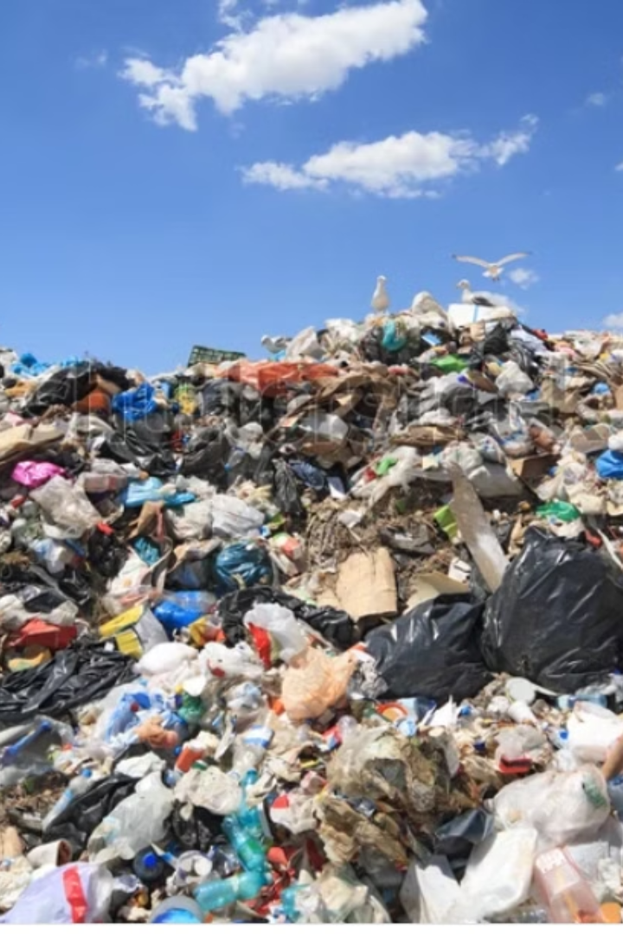
The grave problem of managing ever growing waste in India
Due to ever growing population the amount of waste generated is rising at and alarming exponential rate and hence managing this waste becomes a severe menace for the administrative authorities.
Therefore, we strive to solve this problem using our own model which aims at detecting different wastes and then segregating them into classes for better waste disposal.

Slide 3
Our Vision :
Waste Detection
Waste Segregation
We were bestowed with the problem of Detecting different waste items and then effectively Segregating them for better waste disposal and management.​
Our project focuses on using computer vision algorithms to detect different waste types and segregate them into three categories:​
Recyclable Waste​
Non-Recyclable Waste​
Hazardous Waste

Slide 4
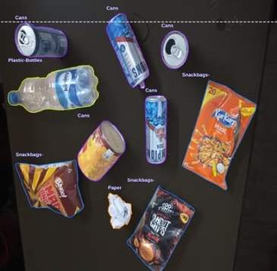
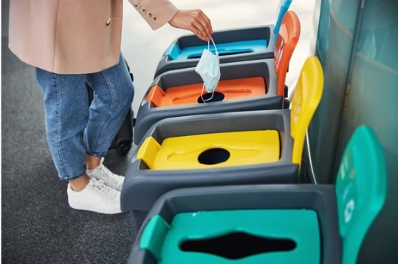
Proposed Solution
1
Vision
2
The 3 Types of Waste
To develop a Smart Waste Segregator Model (SSM) that detects, classifies, and directs waste for proper disposal using a YOLOv8-based computer vision model.
Our model aims to categorize waste into these three broad categories:
RECYCLABLE ['cardboard_box','can','plastic_bottle',​
'scrap_paper','cardboard_bowl']​
NON_RECYCLABLE = ['plastic_bag', 'plastic_bottle_cap',​
'plastic_cup', 'snack_bag', 'plastic_box', '​straw',
'plastic_cup_lid', 'plastic_spoon’]​
​HAZARDOUS = ['battery','light_bulb']

Slide 5
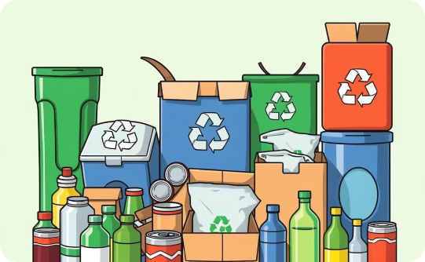
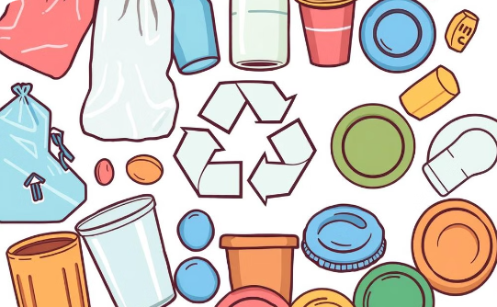
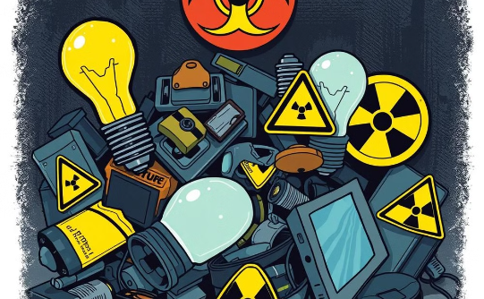
Key Classifications :
Recyclable
Non-Recyclable
Hazardous
Cardboard box, can, plastic bottle, scrap paper, cardboard bowl
Plastic bag, plastic bottle cap, plastic cup, snack bag, plastic box, straw, plastic cup lid, plastic spoon
Battery, light bulb

Slide 6




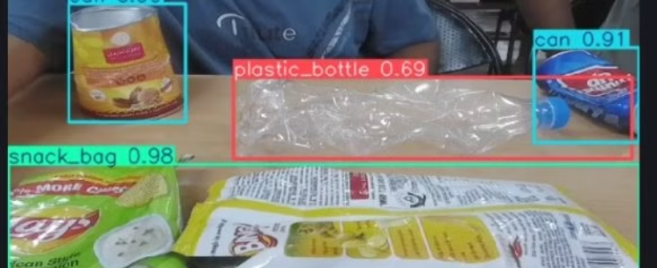
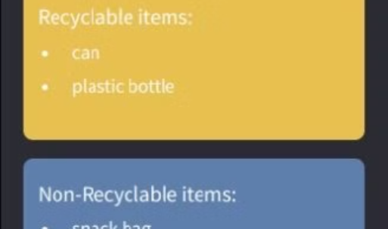
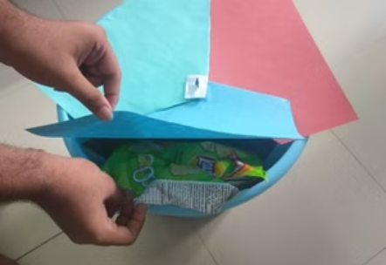
PROPOSED PIPELINE
Data Input
Image Classification
Waste Disposal
Segregated Waste​
Real-time image capture of waste items.
Using YOLOv8 to classify waste into one of the three categories.
Directing waste to appropriate bins.
The disposed waste can then be segregated and sorted into different categories for recycling, disposal, or special handling.​

Slide 7
Project Timeline:
Data Collection
1
Collecting Images of waste. Enforced real time collection by clicking images from our devices and even incorporated images from internet.
2
Dataset Creation
Annotating the images collected followed by augmentation and preprocessing and then ultimately creating our own custom dataset to uphold these images.
Model Training
3
Training of Model on our custom dataset using YOLOv8.
4
Dataset Expansion
Expansion of dataset to enhance the accuracy and reliability of the model to a larger extent.
Model Robustness Testing
5
Testing the robustness of our trained model considering
and analysing different scenarios.
6
QIDK Kit Integration
Attempted and partially succeeded in uploading and running the model on QIDK kit using Android Studio App.
Hardware Implementation
7
Implementing the hardware architecture to run our trained YOLOV8 model.
8
DEVELOPING WEB BASED APPLICATION TO PROVIDE AN END TO END SOLUTION WHICH CATERS TO THE NEEDS OF THE USER :
The streamlit based web application automatically creates rectangular boundaries around waste objects and the digital dashboard notifies the user to throw the waste in thre appropriate bin. We have also implemented a colour scheme for the bins that makes our app visually appealing and user-friendly.
DATA ANALYSIS OF DETECTED WASTES USING GRAPHS :
9
Analysed the wastes detected over time with the help of definitive and descriptive graphical objects like pie charts,bar graphs, heatmaps etc.

Slide 8
Timeline: Waste Detection and Segregation
1. Data Collection
1
We collected around 631 various images all over IIITH campus and around 4000 images from an available dataset, incorporating a total of 4566 images in our dataset.
2
2. Annotation
We annotated those 4566 images on the Roboflowapp and segregated them into 15 waste classes.15 waste classes further subdivided into 3 types:
3. Preprocessing and Augmentation
Recyclable
3
Non Recyclable
We properly oriented and resized the images, then applied a counterclockwise and clockwise flip to augment and get 10894 images in our dataset. This helped make our model more accurate.
Hazardous
4
4. Training and Testing
We trained our model on our custom dataset using YOLOv8.
Now that we had a solid dataset and an initial model trained, we moved forward with statistical analysis to evaluate its accuracy and identify areas for improvement. We made earnest efforts to critically analyse the model and were committed to refining the model until it could reliably detect and segregate waste with high precision. However, we can't deny the scope for further improvements.
5. Statistical Analysis of our model
5
We present an overall graphical overview of the performance metrics of our model to provide a mathematical and analytical perspective of our model. We critically analysed the parameters that majorly impact the performance of our models namely accuracy,precision and recall etc. The performance analysis of both the models follow.
6
6. QIDK Kit Integration
We ultimately succeeded in uploading and running the model on QIDK kit using Android Studio App. However, we encountered a serious problem, issue being that some items being detected are not as intended by our model.
7. Hardware Implementation
7
Implemented the hardware architecture to run our trained YOLOV8 model.
8
8. DEVELOPING WEB BASED APPLICATION TO PROVIDE AN END TO END SOLUTION WHICH CATERS TO THE NEEDS OF THE USER :
9. DATA ANALYSIS OF DETECTED WASTES USING GRAPHS :
Completed the mentioned task with the help of streamlit app that runs and proceeds by creating rectangular boundaries around waste objects for better identification and segregation.
9
Introduced live data analytics of wastes detected over time. This can be of immense use to the user if the user is interested in knowing which types of wastes are being generated and in what proportion.

Slide 9
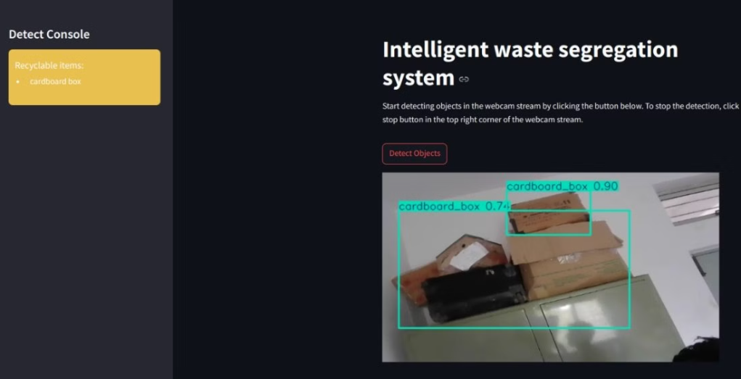
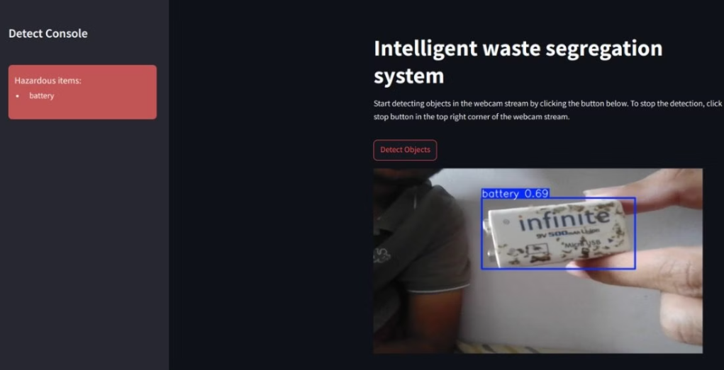
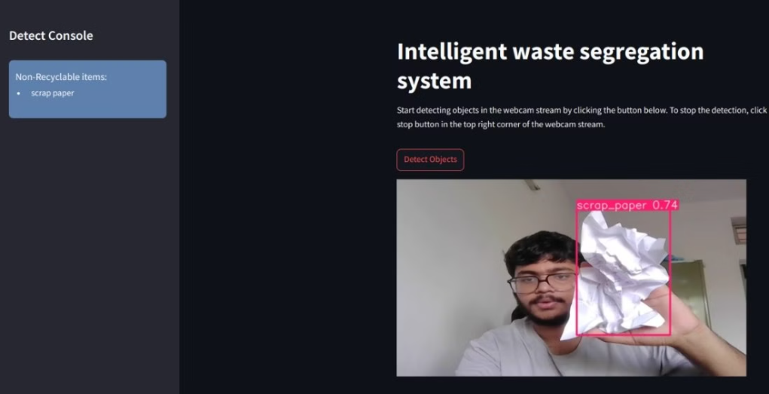
Outcomes and results obtained:

Slide 10
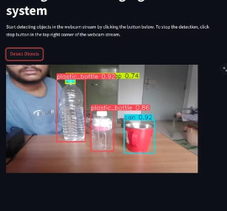
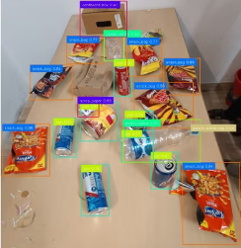
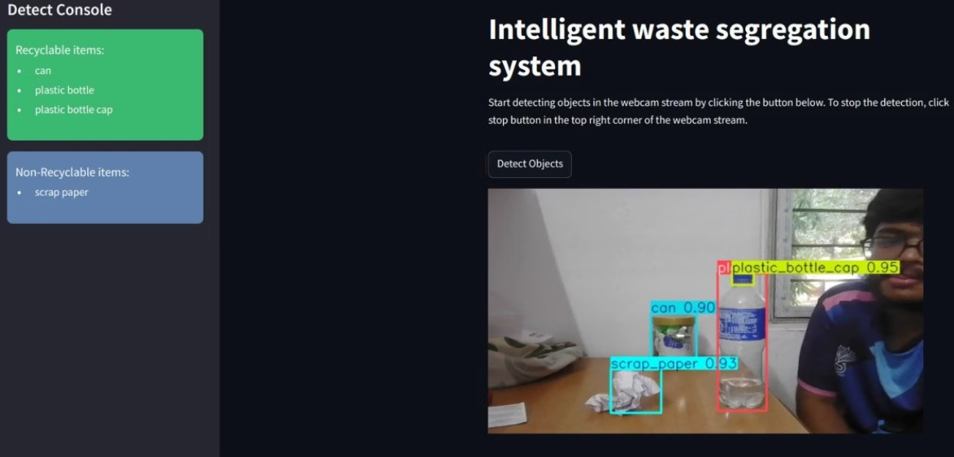

Slide 11
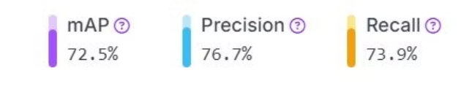
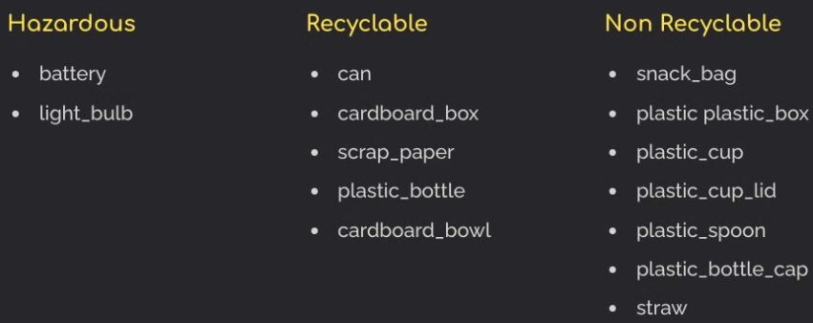
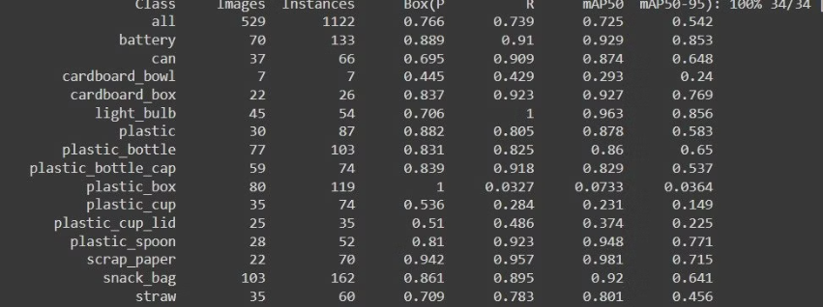
5. Complete Statistical Analysis of our model
YOLOV8 Model Analysis
Data Summary
Model Accuracy
Image Count: 10894 images
We hereby present certain important parameters that provide an overall outline of our model's performance:
Training Set: 10145 images
Validation Set: 529 images
Test Dataset: 220 images
Types of wastes included:
Classwise Analysis:
Augmentation: Counterclockwise and Clockwise Flip (1:3 Augmentation)

Slide 12
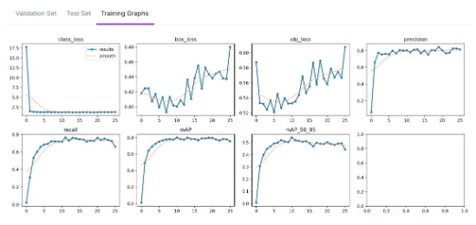
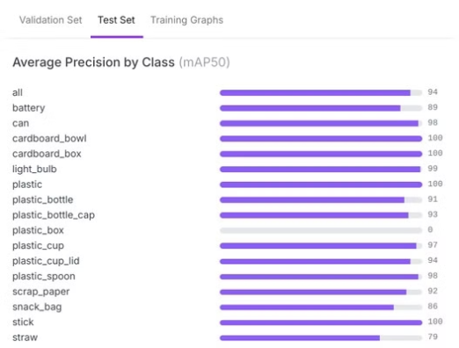
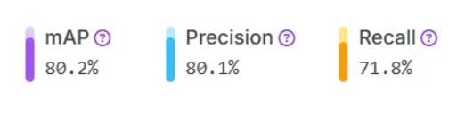
YOLO-NAS Model Analysis (more accurate) :
Accuracy and precision parameters of YOLO-NAS model:
Graphical Overview:
Categorical Analysis:

Slide 13
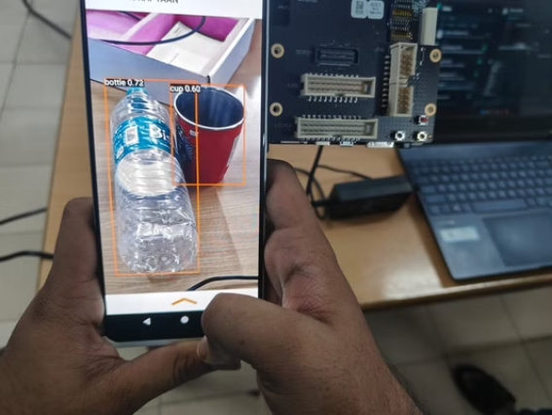
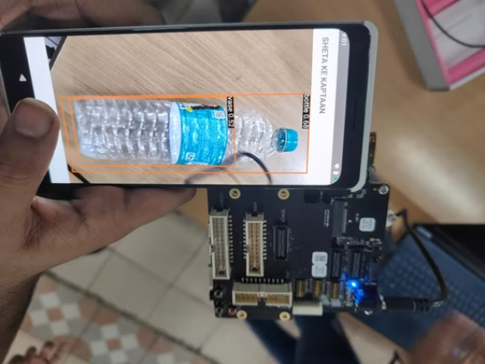
6 & 7. Model Integration on Android Device using QIDK kit
Real time waste detection and analytics

Slide 14
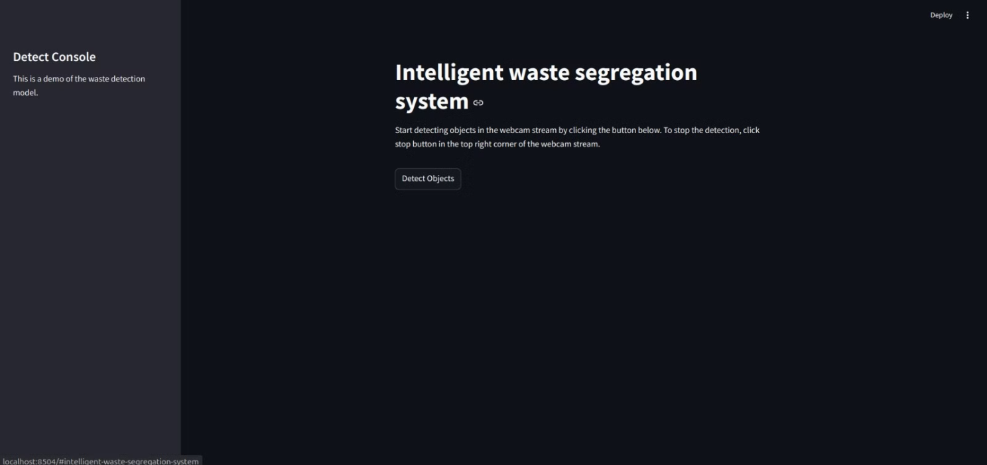
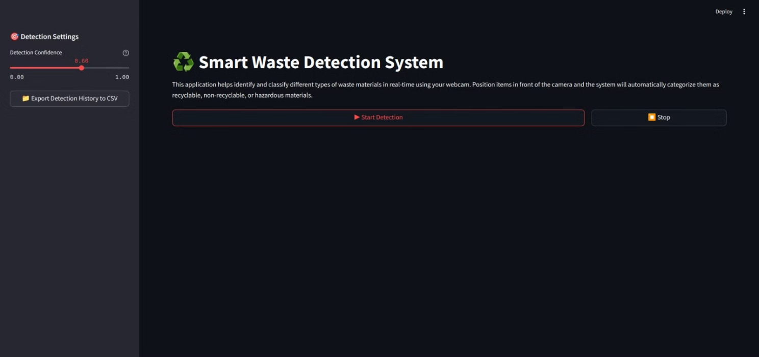
8. WEB-BASED USER FRIENDLY APPLICATION DEVELOPMENT
Initial Development Phase with less visual appeal and features but higher latency
Final application with more user friendly features and satisfactory latency and throughput

Slide 15
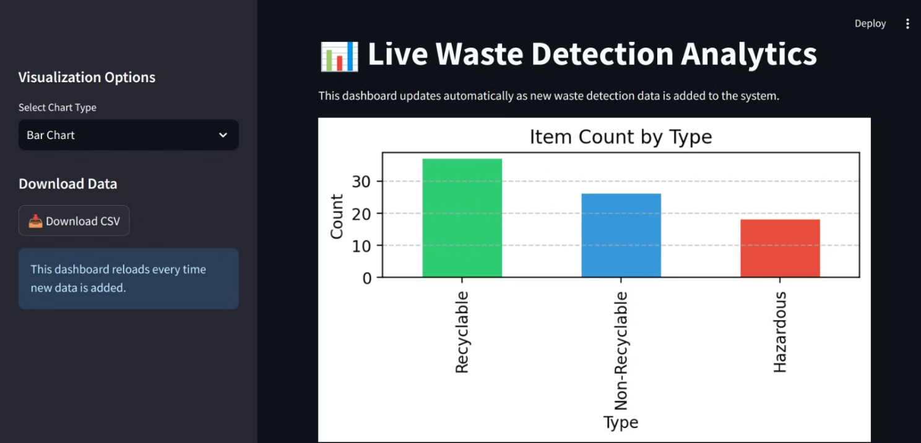
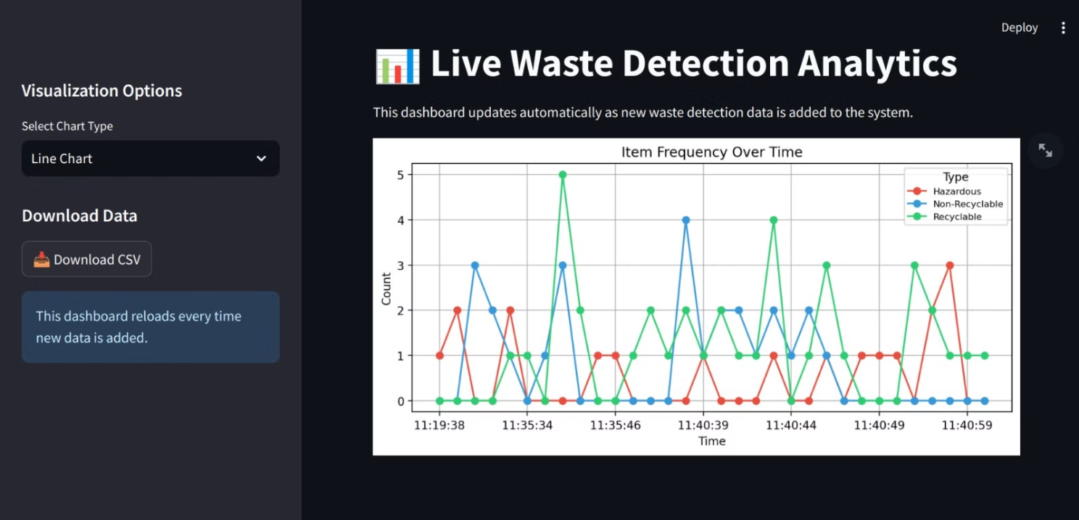
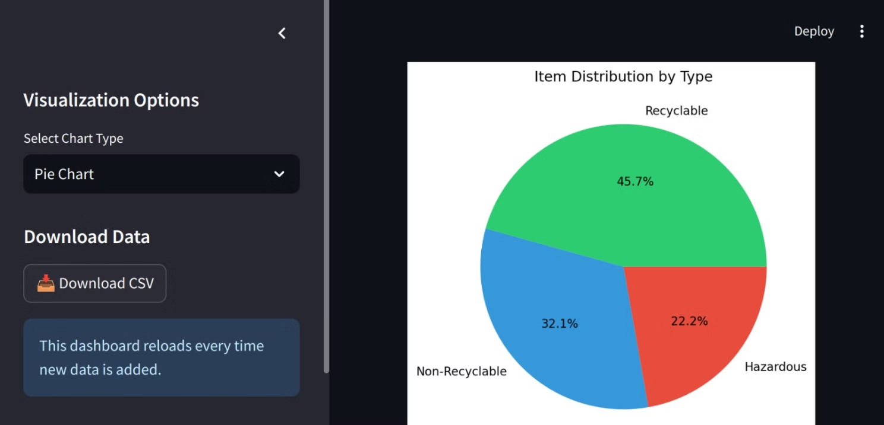
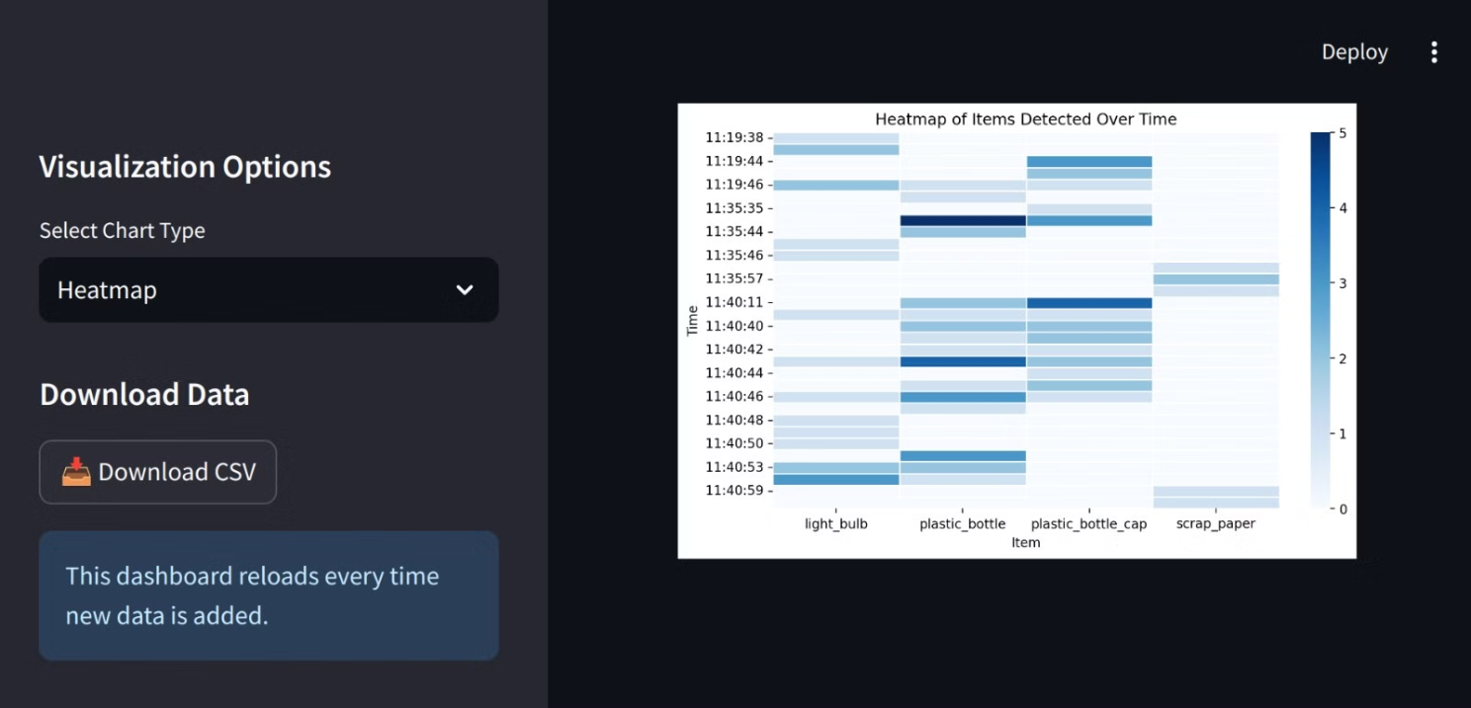
9. DATA ANALYSIS OF DTECTED WASTES USING GRAPHS
Different graphical objects used for better description and visual analysis:

Slide 16
Challenges Faced
Technical Challenges
Hardware Challenges
Miscellaneous Challenges
1. Over-augmentation leading to inaccuracy in our model.
1. Integrating the model with the QIDK kit on Android devices poses a challenge.
1. Despite our utmost and sincere efforts the model can undeniably be optimised or implemented in a more accurate way and there is further scope of improvement.
2. Ensuring compatibility across devices, including the QIDK Android setup.
2. Real-Time Processing Latency: Optimizing the model to reduce latency is critical for real-time waste classification.
3. Model reliability depends on light conditions; further processing needed for variable lighting.

Slide 17
THANK YOU!!
We are extremely grateful to you for viewing and examining our model.
We solicit your valuable suggestions that can help us improve our model and its real-world impact.

Slide 18
Personal Contributions:
Ayush Sheta
Soham Sadavarte
Kavya Bhalodi
Shivam Gupta
Spearheaded the development of the model from scratch and played a major role in data collection and analysis. Helped in troubleshooting and optimising both YOLOV8 and YOLONAS models.
Made important and necessary advances towards the development of both the models YOLOV8 and YOLONAS and helped in the analytical and critical analysis of model along with data collection.
Played a crucial role in the integration of model on QIDK kit and gave valuable insights into the presentations of the project. Also contributed towards data collection and hardware implementation.
Dealt with the presentations and reports of the project and made significant contribution towards data collection,hardware implementation and model integration.

